Slide 1
Yelp Project
Randyll Bearer, Raj Patel, Zachary Barlotta
CS1981 - Fall 2017

Slide 2
In The Beginning...
You gave us a project
“[to build] a voice UI against our public API”
Gave us a lot of freedom
Which meant having to make a lot of decisions
So we did some planning
Notes:
Unknown unknowns:
- we found out our deployment tools was putting our code on a server which had very sparsely documented auto-threading leading to a lot of data race issues
- Two weeks after deciding to go with the google home and researching and studying how to develop for it, Google completely rebranded and switched software

Slide 3
How We Approached The Problem
Step One: Determine what we need:
A voice-to-text/text-to-voice language processor
A way to deploy what we had programmed
A map of possible conversations
Step Two: Research:
What tools currently exist?
Are there any which meet all of our requirements?
Notes:
Unknown unknowns:
- we found out our deployment tools was putting our code on a server which had very sparsely documented auto-threading leading to a lot of data race issues
- Two weeks after deciding to go with the google home and researching and studying how to develop for it, Google completely rebranded and switched software

Slide 4
Tools We Considered Using
Other voice ui (Amazon Alexa, Siri)
Siri: Already has Yelp support
Alexa: Simulation did not support voice input
Other servers (Microsoft Azure, Amazon AWS)
Firebase was already integrated into Google services
Final decision: Google Assistant

Slide 5




Tools We Ended Up Using

Slide 6
The Last Time We Met
We came to you with our plan to develop a voice UI for the Google Home
We kind of did this, technically made a voice UI for the Google Assistant
We provided our idea for what kind of functionality we would implement
Be able to search nearby by category, search by specific business name.
You provided your own ideas
Have the voice UI suggest a random place to eat
Allow the voice UI to enable the user to write their own reviews
Unfortunately couldn’t implement this one through the public API
Notes:
Unknown unknowns:
- we found out our deployment tools was putting our code on a server which had very sparsely documented auto-threading leading to a lot of data race issues
- Two weeks after deciding to go with the google home and researching and studying how to develop for it, Google completely rebranded and switched software

Slide 7
This Time...
We actually have some stuff to show
Implemented Features:
VagueSearch: Allows the user to search nearby restaurants by category and returns the suggested best match. (E.g. “Find Chinese near me”)
DirectSearch: Allows the user to search nearby restaurants specifically by name (E.g. “Look up Piada”)
RandomSearch: Allows the user to ask for somewhere to eat and returns a randomly suggested nearby restaurant.
A Demonstration
Notes:
Unknown unknowns:
- we found out our deployment tools was putting our code on a server which had very sparsely documented auto-threading leading to a lot of data race issues
- Two weeks after deciding to go with the google home and researching and studying how to develop for it, Google completely rebranded and switched software

Slide 8
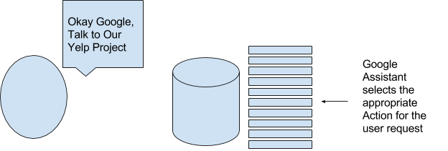
A Quick Little Graphic
- In its Idle state, the Google Assistant eavesdrops until it hears a request which corresponds to a known Action.

Slide 9
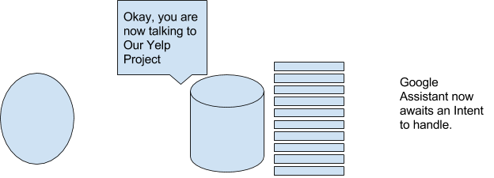
A Quick Little Graphic
- After loading an Action, the Google Assistant now eavesdrops until it hears a request which it can match to an Intent.

Slide 10
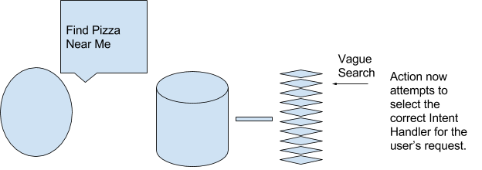
A Quick Little Graphic
- Once the Action hears a request which will trigger an Intent, it loads that Intent to handle the request.

Slide 11
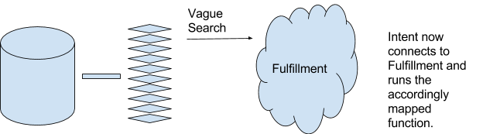
A Quick Little Graphic
- Once the Intent has been loaded, it needs to contact the Fulfillment code to actually fulfill the user request. Each Intent has its own mapped function in the Fulfillment.

Slide 12
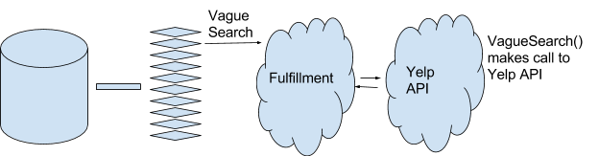
A Quick Little Graphic
- Once called, the Fulfillment will do all the actual work, including making calls to the Yelp Fusion API.

Slide 13
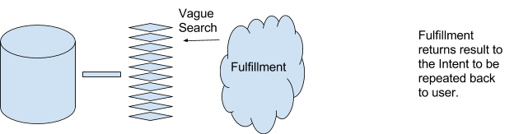
A Quick Little Graphic
- Once the Fulfillment has completed execution of its code, it will return a String result back to the Intent.

Slide 14
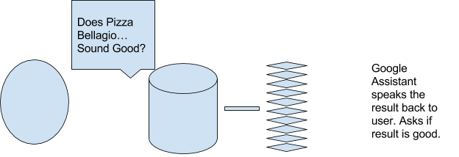
A Quick Little Graphic
- Once the Intent has the Fulfillment’s result string, it will tell the Google Assistant to speak the result back to the user.

Slide 15
What We Learned
A lot of JavaScript, mainly our first time.
How to think through a problem effectively before you attempt to solve it.
Steve helped us a lot with this.
How poorly documented new tools might be.
It now makes sense why you might not always choose to go with the cutting-edge.
Experience communicating with Stakeholders

Slide 16
Thank You!

